Slide 1
Transformers
Lucas Liu, John Kang, Wei Sun
03/19/2024 and 04/02/2024

Slide 2



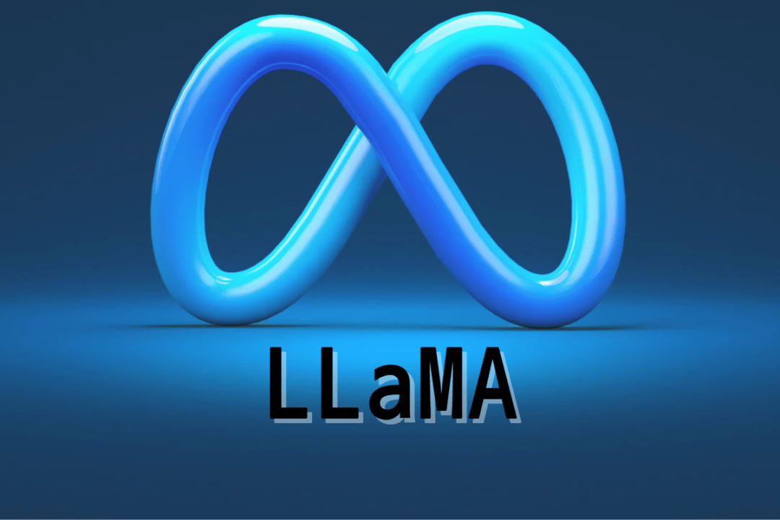
Large Language Models and Transformer
GPT – Generative Pre-trained Transformers
BERT - Bidirectional Encoder Representations from Transformers
LLaMA - Large Language Model Meta AI
Bard is now Gemini

Slide 3
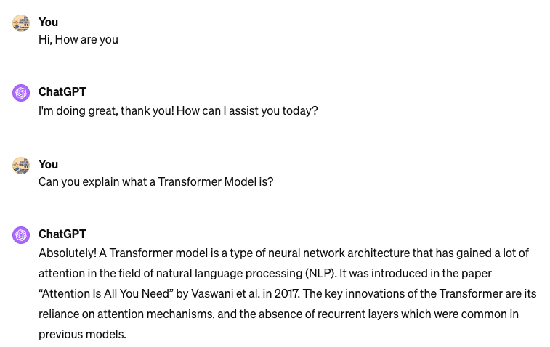
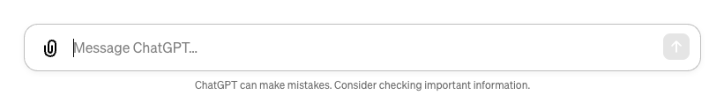
ChatGPT

Slide 4

Attention is All You Need
Vaswani, Ashish, et al

Slide 5
Transformer
Sequence transduction model: Convert input sequence into an output sequence.
Translation
Text Generation
谢谢你
I am doing great.
Transformer
Transformer
Thank you
How are you?
Other Tasks: Text summarization, Sentiment analysis, Image Classification , etc.

Slide 6
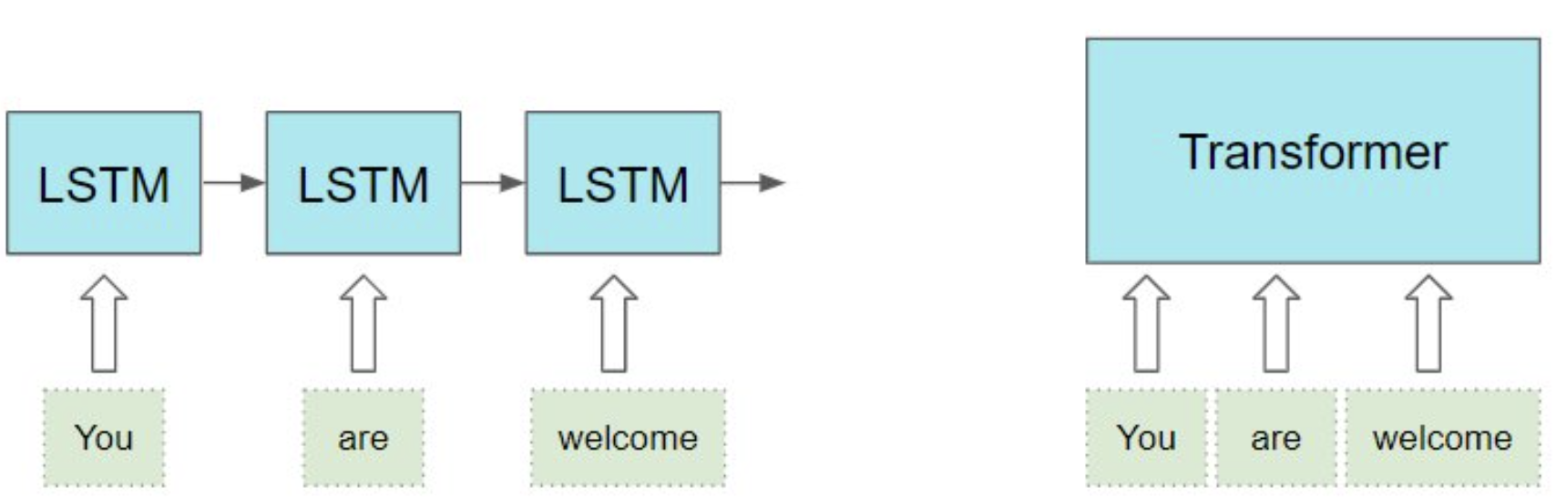
Recurrent Neural Network vs Transformer
Recurrent Neural Networks
  To process a sequence of words, it is natural to adopt a recurrent process: use the output of the first k-words as the input when process the k+1-th word.
  They often struggle with long-range dependencies
  They cannot be easily parallelized due to their sequential nature
Transformers
  They process the entire sequence simultaneously instead of sequentially, thus enable paralleled computing
  They rely entirely on attention to compute representations of the input.
    An attention score is computed as the similarity of two words in the sentence.
Image from https://towardsdatascience.com/transformers-explained-visually-part-1-overview-of-functionality-95a6dd460452

Slide 7
Attention
“An attention mechanism relating different positions of a single sequence in order to compute a representation of the sequence”
Associate each words to other words
Allows the model to focus on the most important parts of the sequence
0.6
0.2
0.1
Hi
How
are
you
….
….
….
….
….

Slide 8
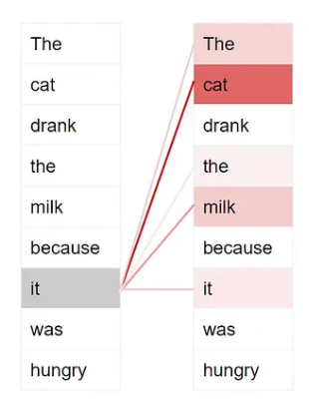
Attention Example1
Output
complete sentence
The cat drank the milk because it was hungry.
Transformer
Input
Incomplete sentence
The cat drank the milk because
Dark color represent higher attention
https://towardsdatascience.com/transformers-explained-visually-part-1-overview-of-functionality-95a6dd460452

Slide 9
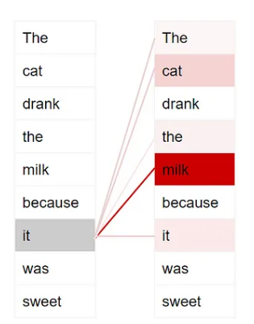
Attention Example2
Output
complete sentence
The cat drank the milk because it was sweet.
Transformer
Input
Incomplete sentence
The cat drank the milk because
https://towardsdatascience.com/transformers-explained-visually-part-1-overview-of-functionality-95a6dd460452

Slide 10
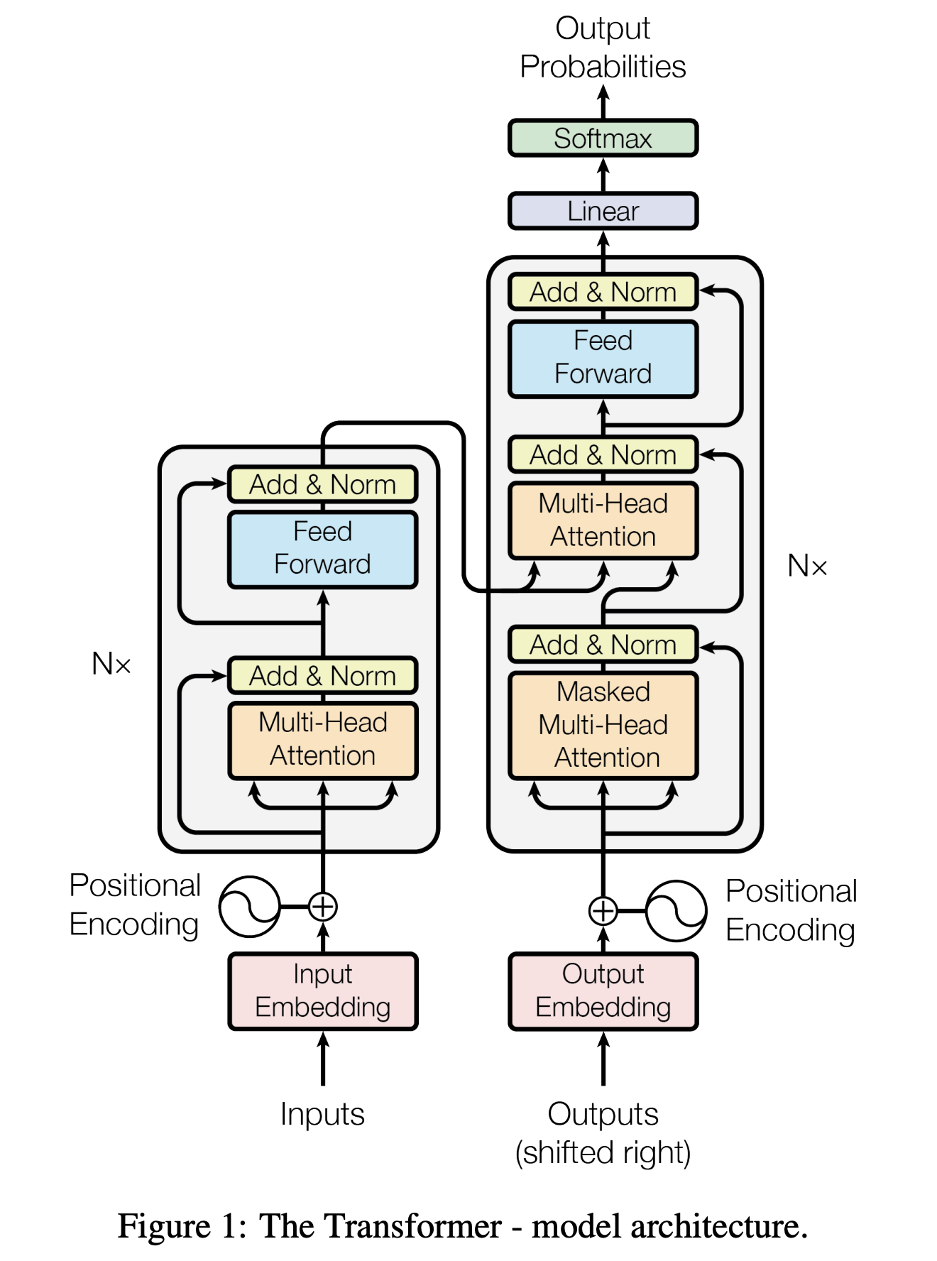
Transformer
Decoder
Encoder
Vaswani, Ashish, et al.

Slide 11
Example
Text Generation
Output
I am doing great.
Transformer
Input
How are you?

Slide 12
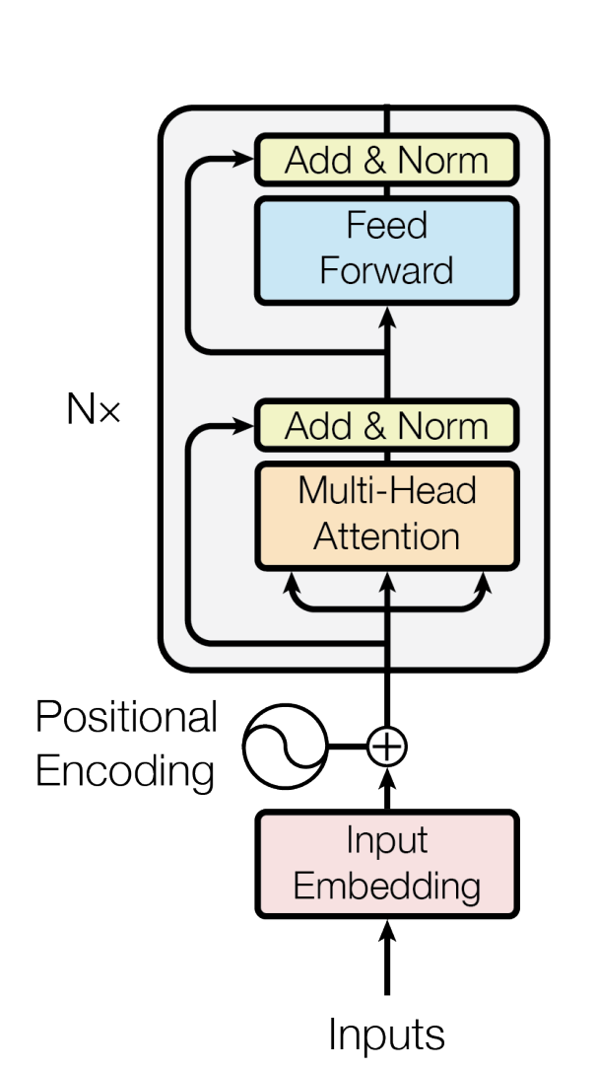
Input Embedding
Encoder
Input
Embedding
Hi
How
are
you

Slide 13
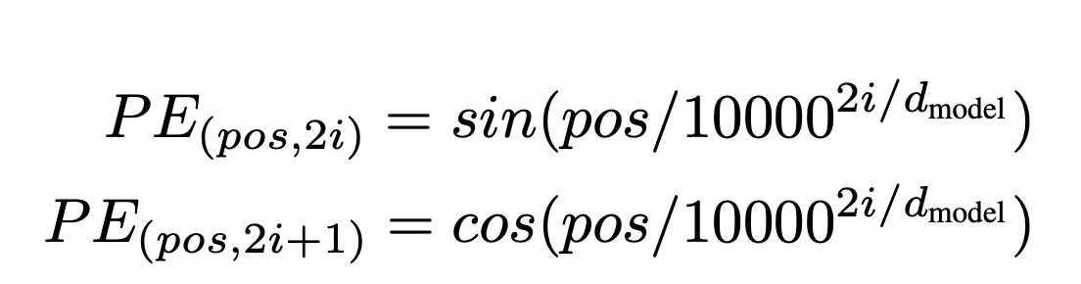



Position Encoding
Positional
Input
Embedding
Encoder
Combine
$$+$$
$$+$$
$$+$$
$$+$$
Use sin and cos wave frequency to encode the positional information
Positional Encoding
Position
pos = 0
pos = 1
pos = 2
pos = 3
Input
Embedding
Hi
How
are
you

Slide 14

Encoder Layer
Encoded
Input
Encoder
Add & Norm
Feed
Forward
$$N×$$
Add & Norm
Multi-head
Attention
Positional
Input

Slide 15
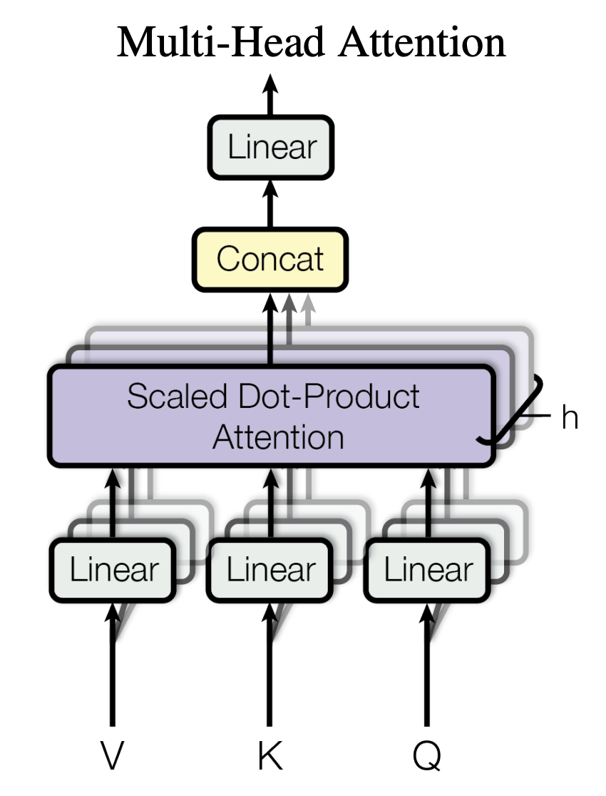
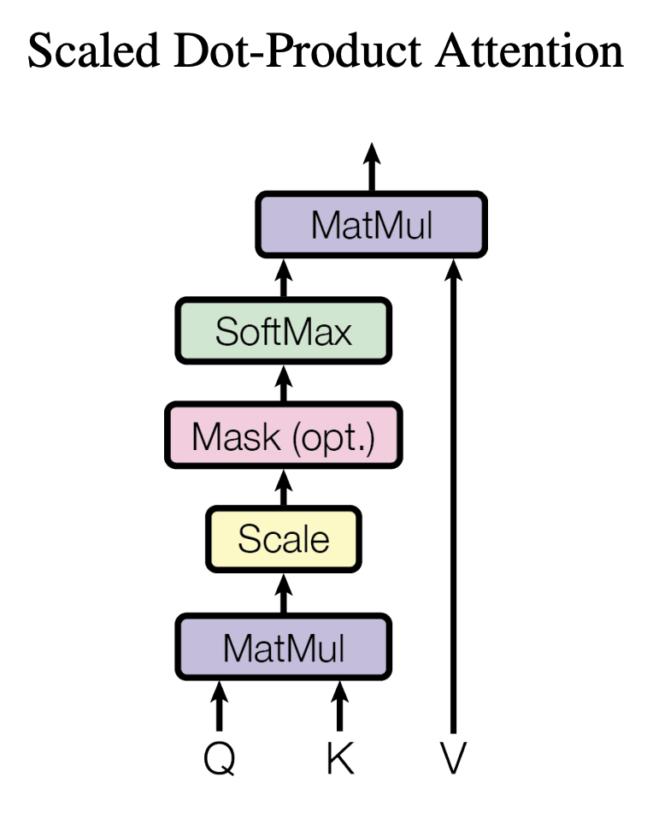

Multi-Head Attention and Self-Attention
Add & Norm
Self-Attention
Feed
Forward
Multi-Head Attention
Scaled Dot-Product Attention
$$N×$$
Add & Norm
Multi-head
Attention
V: Value, K: Key, Q: Query (Hidden States)
Use these states to compute attention and encoded input representation

Slide 16
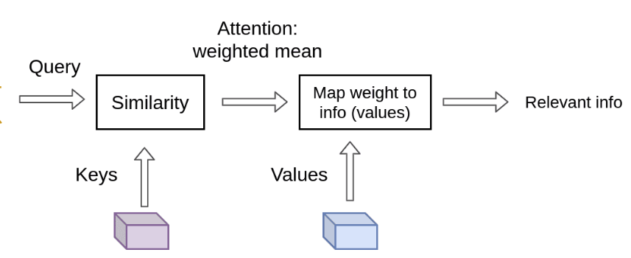
Query, Key and Value
Query
Key
Value
Linear
Linear
Linear
Image from https://theaisummer.com/transformer/
Hi
How
seq
are
you

Slide 17





Self-Attention for one word
For each word in the query, find the its association with a set of keys
The dot-product of the query with all the keys (attention weights)
$$Q$$
Attention Weights
Hi
$$K^{T}$$
Hi
are
How
are
×
How
you
$$=$$
0.3 | 0.1 | 0.1 | 0.5
are
are
Hi
are
How
you
you
The encoded representation is a weighted sum of the values
Attention Weights
$$V$$
Hi
Encoded Representation
Hi
are
How
you
0.3 | 0.1 | 0.1 | 0.5
×
$$=$$
are
How
are
are
you

Slide 18
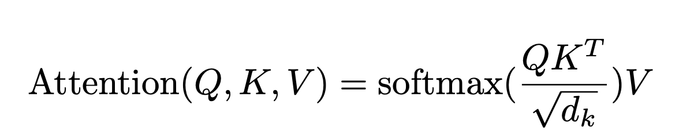





Self-Attention
Hi
How
are
you
Q
$$K^{T}$$
seq
Hi
0.3 | 0.1 | 0.1 | 0.5
0.1 | 0.6 | 0.2 | 0.1
0.1 | 0.3 | 0.3 | 0.3
0.3 | 0.1 | 0.4 | 0.2
seq
×
How
$$Softmax$$
$$=$$
are
$$\sqrt{d_{k}}$$
you
Attention Weights
Attention Weights
Value
Encoded Representation
×
seq
$$=$$
seq

Slide 19
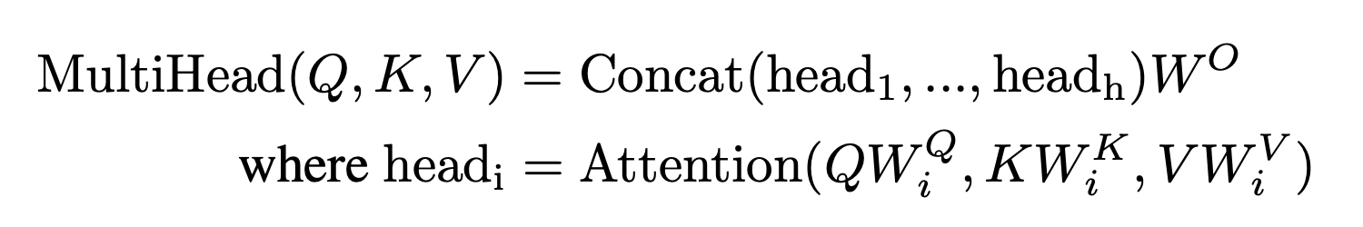
Multi-Head Attention
Each head learns a different aspect of sentence.
  One head might see the relationship between nouns
  Another head may see relationship between nouns and verbs.
These heads can also be vectorized and computed in parallel.

Slide 20
Multi-Head Attention​
Output
Linear
Concatenated Output
Output1
Output2
Self-Attention Head 1
Self-Attention Head 2
Query1
Key1
Value1
Query2
Key2
Value2
1
2
Query
Key
Value

Slide 21

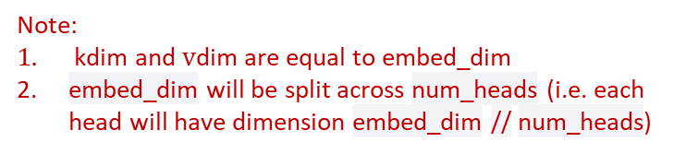



Multi-Head Attention​
Output
Note:
$\text{kdim}$and $\text{v}\text{dim}$ are equal to embed_dim $⁡$
embed_dim will be split across num_heads (i.e. each head will have dimension embed_dim // num_heads)
Linear
$$(qdim)$$
$(kdim$)
($vdim$)
Concatenated Output
Query
Key
Value
Output1
Output2
Self-Attention Head 1
Self-Attention Head 2
Query1
Key1
Value1
Query2
Key2
Value2
1
2
Linear
Linear
Linear
Linear
Linear
Linear
Input Embedding
$ℝ^{embed_{dim}× n_{words}}$
seq

Slide 22


Residual Connection and Layer Normalization
Residual Connection
Add & Norm Output
Encoder
LayerNorm
$$+$$
$$=$$
Attention Output
Residual
Connection
(Add)
Multi-head
Attention
Input

Slide 23
Feed Forward
Encoder
Encoder Output
Linear
Add & Norm
Relu
Linear
Feed Forward Layer
Add & Norm Output

Slide 24
Example
Text Generation
Output
I am doing great.
Decoder
Transformer
Input
How are you?
Encoder

Slide 25
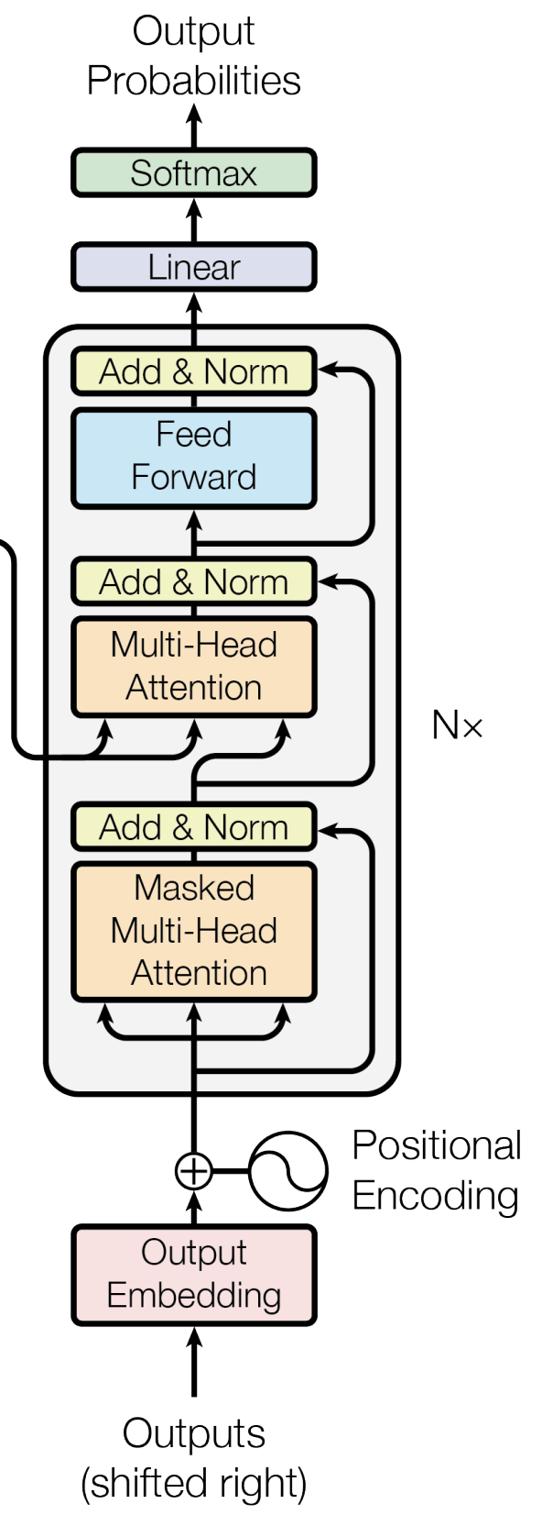
Decoder Layer
Linear Classifier
Encoder- Decoder
MHA
Decoder
MHA

Slide 26
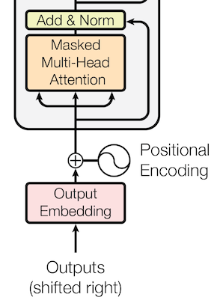
Decoder MHA
Output Embeddings
Masked
Decode MHA
Positional
Output
<Start> I am doing great

Slide 27
Decoder MHA
Look Ahead Masking
<Start> I am doing great
<Start>
0.6 | 0.1 | 0.1 | 0.1 | 0.1
0.1 | 0.5 | 0.1 | 0.1 | 0.1
0.1 | 0.3 | 0.6 | 0.1 | 0.2
0.1 | 0.3 | 0.2 | 0.4 | 0.3
0.2 | 0.2 | 0.4 | 0.7 | 0.1
I
am
Decoder
MHA
doing
great

Slide 28
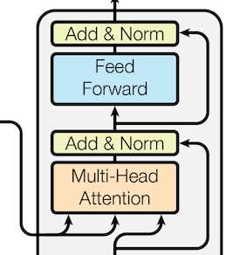
Encoder- Decoder MHA
K: Input From Encoder
Encoder- Decoder
MHA
V: Input From Encoder
Q: Output from Decoder MHA

Slide 29





Encoder- Decoder Attention
Query: Output from Decoder MHA
Key : Input From Encoder
Attention Weights
Hi
How
are
you
Q
$$K^{T}$$
<Start>
0.6 | 0.2 | 0.1 | 0.1
0.1 | 0.2 | 0.1 | 0.6
0.1 | 0.3 | 0.5 | 0.1
0.1 | 0.6 | 0.2 | 0.1
0.1 | 0.7 | 0.1 | 0.1
seq
seq
×
I
$$Softmax$$
$$=$$
am
$$\sqrt{d_{k}}$$
doing
great
Attention Weights
Output Representation
Value
×
$$=$$
seq
seq
V: Input From Encoder

Slide 30
Linear Classifier
Index = 4, associated word is Hi
Linear Classifier
…
N Class (Vocab size)
0.8 | 0.2 | 0.0 | 0.1 | 0.9 | 0.0
0.1 | 0.2 | 0.0
Softmax
Linear
seq

Slide 31
Loss Function
Hi
Desired Output
…
0.0 | 0.0 | 0.0 | 0.0 | 1.0 | 0.0
0.0 | 0.0 | 0.0
Compare the two distribution and compute the loss.
Bye
Untrained Model Output
…
0.3 | 0.1 | 0.0 | 0.1 | 0.1 | 0.0
0.1 | 0.8 | 0.0
CE or
KL-divergence
Parameter Update
Optimizer
Loss Score

Slide 32
Text Generation
Predicting next word one at a time
Feed previous output into the decoder

Slide 33
Text Generation
Predicted Output:
I
am
doing
great
great
doing
am
I
Previous
Output
How are you?
<Start>
I
am
doing
great

Slide 34
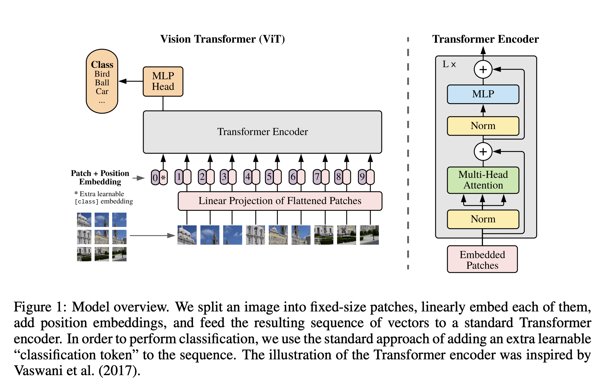
Vision Transformer (ViT)
^{Dosovitskiy, Alexey, et al.}

Slide 35
Reference
Vaswani, Ashish, et al. "Attention is all you need." Advances in neural information processing systems 30 (2017).
Dosovitskiy, Alexey, et al. "An image is worth 16x16 words: Transformers for image recognition at scale." arXiv preprint arXiv:2010.11929 (2020).
https://towardsdatascience.com/illustrated-guide-to-transformers-step-by-step-explanation-f74876522bc0

Slide 36
Transformer for protein sequences

Slide 37
Use Transformer to study T Cell Receptors

Slide 38
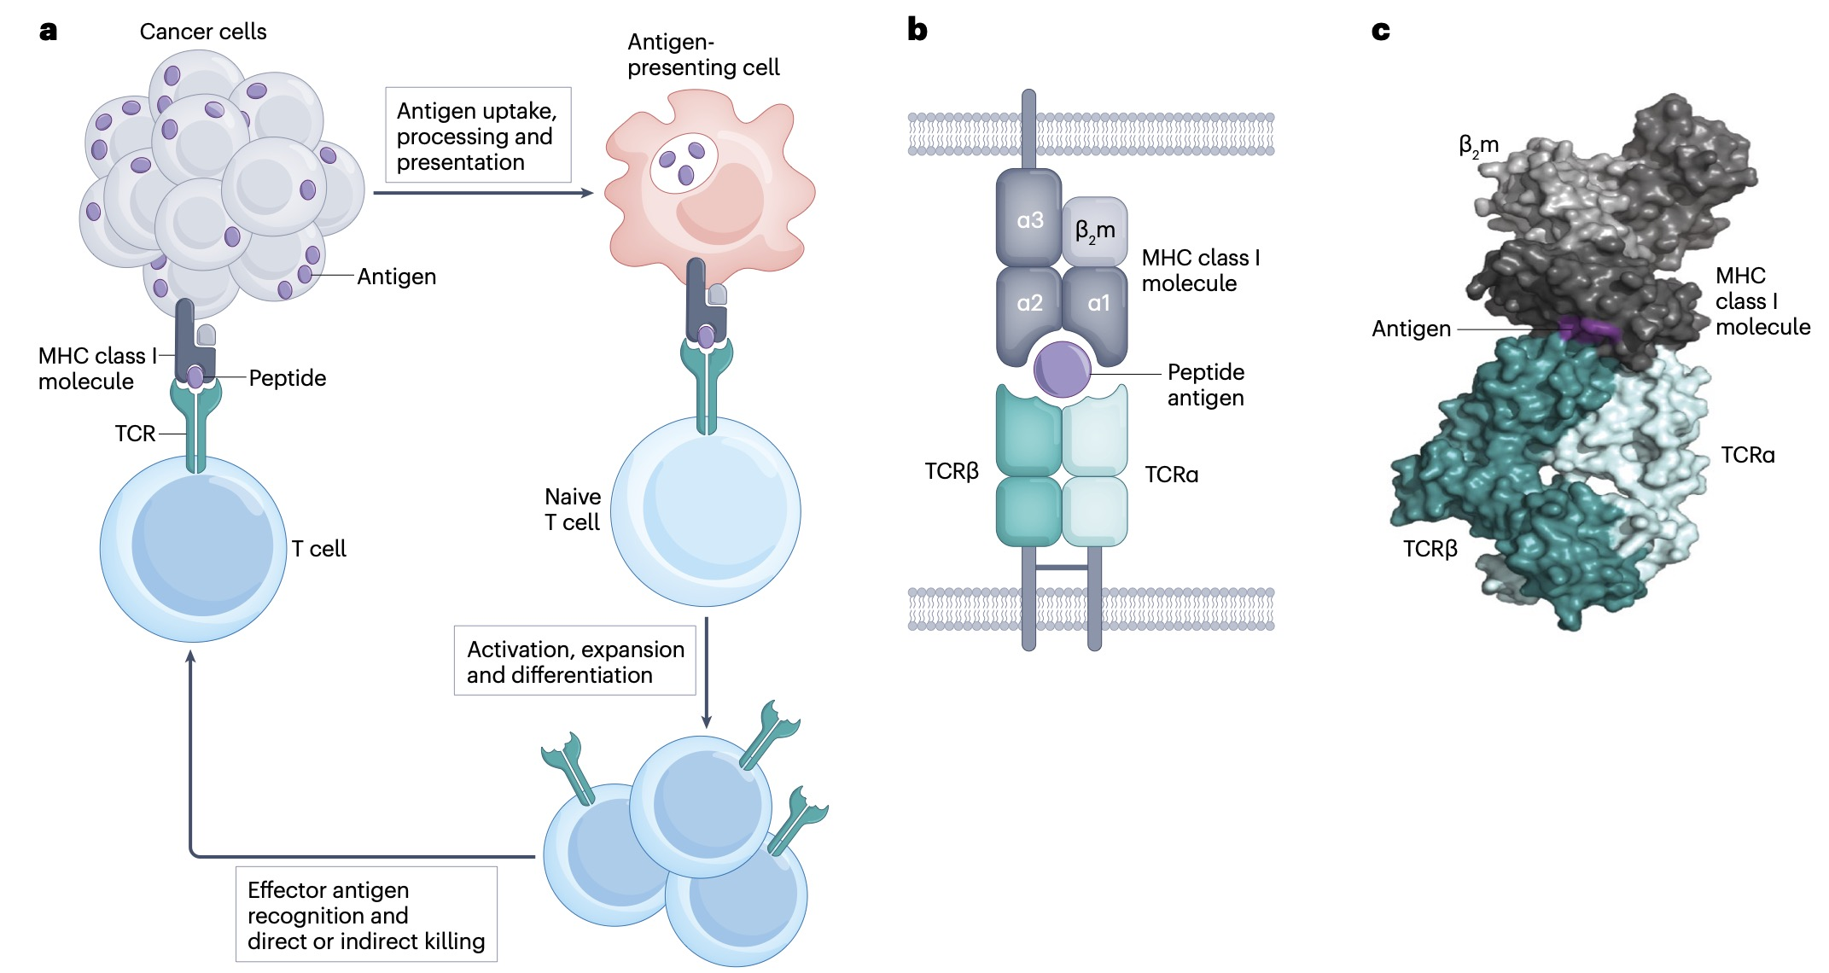
A three-body problem
Hudson, et al., 2023. Can we predict T cell specificity with digital biology and machine learning?. Nature Reviews Immunology, 23(8), pp.511-521.

Slide 39
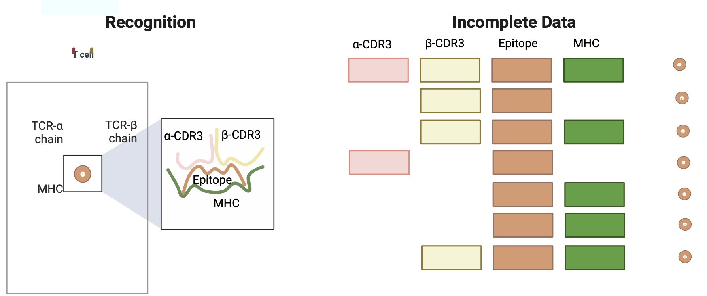
Challenges to predict TCR-antigen interactions:
(1) incomplete data
Meynard-Piganeau, B., Feinauer, C., Weigt, M., Walczak, A. M., & Mora, T. (2023). TULIP—a Transformer based Unsupervised Language model for Interacting Peptides and T-cell receptors that generalizes to unseen epitopes. bioRxiv, 2023-07.

Slide 40
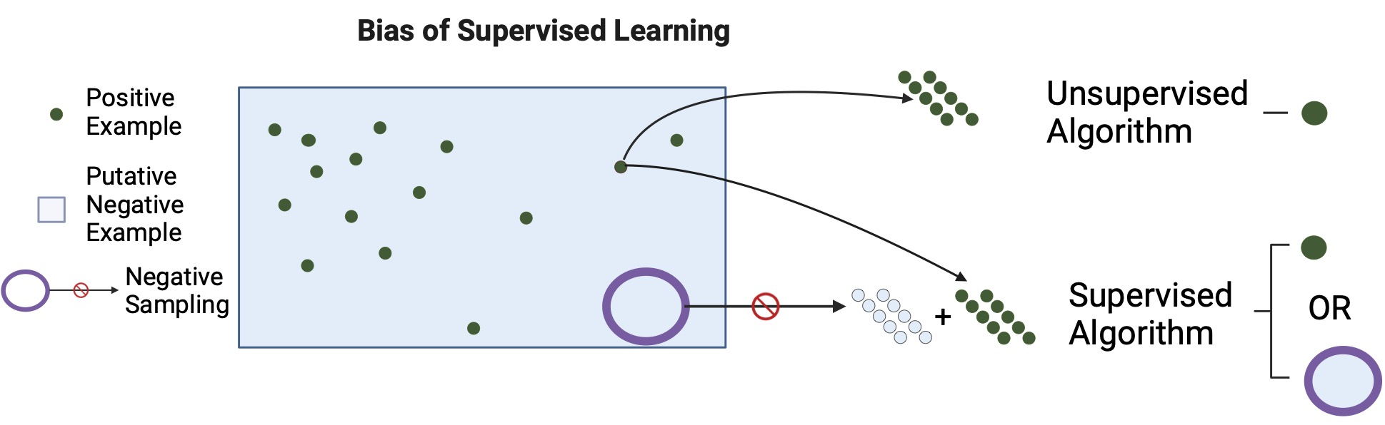
Challenges to predict TCR-antigen interactions:
(1) incomplete data, (2) bias of negative data
Meynard-Piganeau, B., Feinauer, C., Weigt, M., Walczak, A. M., & Mora, T. (2023). TULIP—a Transformer based Unsupervised Language model for Interacting Peptides and T-cell receptors that generalizes to unseen epitopes. bioRxiv, 2023-07.

Slide 41
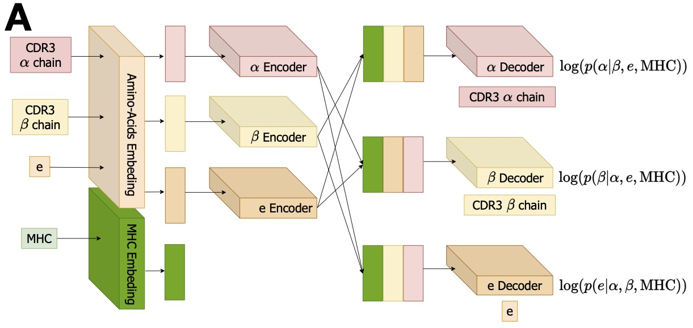
Transformer-based unsupervised language modeling for Interacting pMHC-TCR (TULIP-TCR)
pMHC = peptide-MHC complex
Incomplete data
leveraging all possible data sources
regardless of their quality or completeness
and including single-chain data,
bias of negative data
Use an unsupervised approach to only
learn from positive data.
the encoder receives a protein sequence as input, and the decoder aims to generate an interacting protein sequence
(the translated sentence in NLP) as its objective.

Slide 42
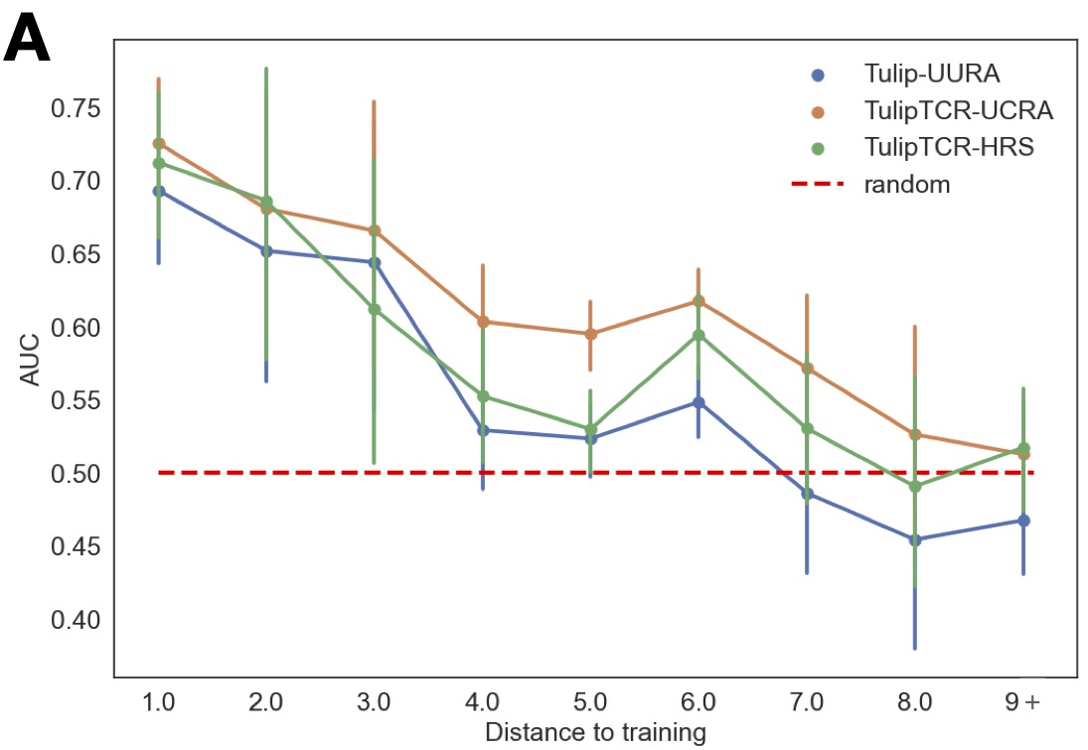
Limited performance
UURA: Unseen Unconnected Random Association
UCRA: Unseen Connected Random Association
In the Healthy Repertoire Sampling (HRS),
the TCR is chosen at random from the repertoire of
healthy individuals

Slide 43
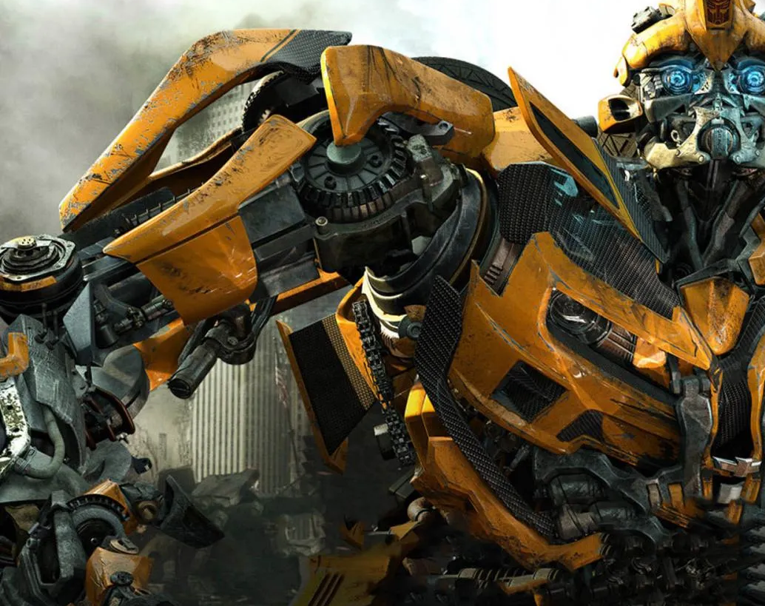
What is driven the success of a Transformer

