Slide 1
Empirical Estimator for GxE using imputed data
Shuo Jiao

Slide 2
Background
Empirical Bayes (EB) is a weighted average of case-only and case-control GxE estimator with the greater weight given to the more efficient case-only estimator if the G-E independence is likely to hold, and to the more robust case-control estimator otherwise.
The case-control estimator is easy to obtain using standard software
The case-only estimator, when g is coded as 0/1, can be obtained from
logit(prob(g=1))~e+x

Slide 3
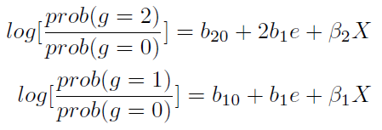
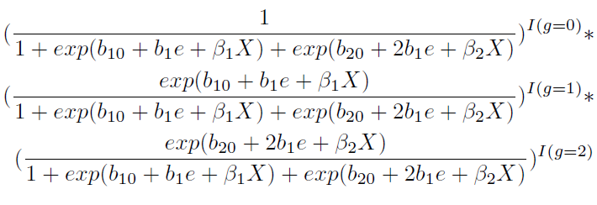
Background
When g=0/1/2, in a similar way to Bhattacharjee S et.al. (2010), we can fit a polytomous logistic regression in cases with some constraint
The likelihood function is

Slide 4
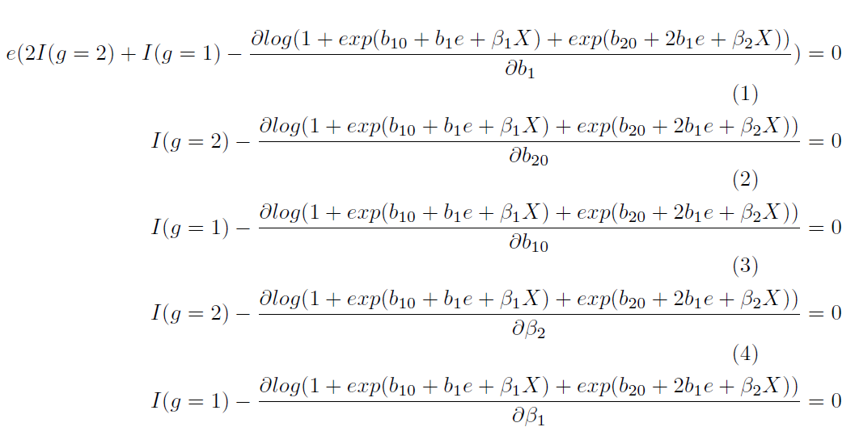
Background
We obtain MLE by solving the score equation (first derivative of the log likelihood function w.r.t the parameters) equal to 0.

Slide 5
Imputed data
For imputed data, we only know the posterior probabilities that g=2,1,0; which are denoted by p2, p1 and p0.
In the score function, since I(g=2) are I(g=1) are unknown, a naïve approach would be to replace them by the imputation probabilities, however, this will yield biased estimators.
Instead, we will replace the indicators by E(I(g=2)|e,x)=prob(g=2|e,x); in cases, e and g are not independent. So prob(g=2|e,x) should be a function of e, x and p2.

Slide 6
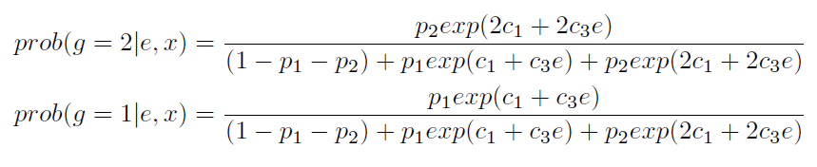
Imputed data
Suppose the true model is
After some derivation, I found out that
Note that c1 and c3 are unknown, we proposed to replace c1 and c3 with the corresponding estimate from case control. In this way, we make use of the posterior probabilities from imputation software in an integrated manner.
By replace I(g=2) and I(g=1) in the score function with the prob(g=2|e,x) and prob(g=1|e,x), we can get the case only estimators.

Slide 7
Variance of estimators
Since in the case-only estimator, we replace c1 and c3 with the corresponding estimators from case control, this introduce more variations and make it complicate to estimate the corresponding variance.
Also, this will make the estimate of corresponding variances of the EB estimator much harder. Because EB is a weighted average of case only and case control estimators, to get the variance of EB, we need to compute the covariance of case only and case control estimates.
Good thing is the difficulty lies in the math derivation part. Once the algorithm is developed, the speed is not affected much.

Slide 8
EB R Function for Imputed Genotypes
EB.function.wt.new(input, model)
  input=data.frame(d,p1,p2,e,w,x)
    d: disease status
    p1 and p2: probabilities of carrying heterozygotic and homozygotic variant genotypes
    e: environmental variables (categorical, continuous)
    w: weight for sample
    x: adjusted covariates (e.g., study, age and sex)
  model: additive, dominant, recessive
Output: a matrix
  Columns: EST_CO, SE2_CO, EST_CC, SE2_CC, EST_EB, SE2_EB
  Rows: g*e

Slide 9
Results
When SNPs are not imputed, which is equivalent to situations where one of p2 p1 and p0 is 1, our method should give similar results as the regular EB method (in CGEN package). Results are from 5000 replicates.
True interaction | G and E correlation | CGEN_EST | CGEN_var | Dosage_EST | Dosage_var
log(1.5) | 0 | 0.409 | 0.029 | 0.410 | 0.029
log(2) | 0 | 0.698 | 0.029 | 0.700 | 0.029
log(1.5) | log(1.25) | 0.486 | 0.037 | 0.487 | 0.038
log(2) | log(1.25) | 0.771 | 0.037 | 0.772 | 0.038

Slide 10
Type I error
1000 imputed SNPs, 5% of which are correlated with E, repeat 1000 times, type I error
Case-control: 0.048
Case-only: 0.162
EB: 0.039

Slide 11
Estimate
When g and e are independent
ge.effect | r2 | bias_EB | SE_EB | SD_EB | bias_CC | SE_CC | SD_CC
0.182 | 0.25 | 0.003 | 0.078 | 0.08 | 0.003 | 0.1 | 0.101
0.182 | 0.49 | 0.004 | 0.037 | 0.036 | 0.006 | 0.052 | 0.052
0.182 | 0.81 | 0.004 | 0.021 | 0.021 | 0.006 | 0.031 | 0.031
0.182 | 0.98 | 0.002 | 0.017 | 0.018 | 0.002 | 0.026 | 0.026
0.405 | 0.25 | 0.015 | 0.081 | 0.079 | 0.019 | 0.104 | 0.101
0.405 | 0.49 | 0.022 | 0.036 | 0.035 | 0.027 | 0.052 | 0.051
0.405 | 0.81 | 0.001 | 0.02 | 0.021 | 0.005 | 0.031 | 0.031
0.405 | 0.98 | -0.004 | 0.016 | 0.018 | -0.004 | 0.025 | 0.025
0.693 | 0.25 | 0.05 | 0.083 | 0.08 | 0.064 | 0.106 | 0.103
0.693 | 0.49 | 0.023 | 0.035 | 0.036 | 0.033 | 0.052 | 0.052
0.693 | 0.81 | 0.008 | 0.02 | 0.021 | 0.014 | 0.03 | 0.031
0.693 | 0.98 | 0.006 | 0.017 | 0.018 | 0.008 | 0.026 | 0.026

Slide 12
Estimate
When g and e are correlated (log(1.2))
ge.effect | r2 | bias_EB | SE_EB | SD_EB | bias_CC | SE_CC | SD_CC
0.182 | 0.25 | 0.084 | 0.084 | 0.085 | 0.006 | 0.102 | 0.102
0.182 | 0.491 | 0.089 | 0.043 | 0.042 | 0.009 | 0.053 | 0.052
0.182 | 0.81 | 0.076 | 0.027 | 0.028 | 0.006 | 0.031 | 0.031
0.182 | 0.98 | 0.067 | 0.024 | 0.024 | 0.006 | 0.027 | 0.026
0.405 | 0.25 | 0.083 | 0.083 | 0.084 | 0.009 | 0.101 | 0.102
0.405 | 0.491 | 0.09 | 0.043 | 0.042 | 0.011 | 0.055 | 0.052
0.405 | 0.81 | 0.077 | 0.028 | 0.028 | 0.009 | 0.033 | 0.031
0.405 | 0.98 | 0.061 | 0.024 | 0.024 | -0.001 | 0.027 | 0.026
0.693 | 0.25 | 0.124 | 0.088 | 0.085 | 0.057 | 0.108 | 0.104
0.693 | 0.491 | 0.101 | 0.044 | 0.042 | 0.028 | 0.056 | 0.053
0.693 | 0.81 | 0.081 | 0.027 | 0.028 | 0.012 | 0.031 | 0.032
0.693 | 0.98 | 0.064 | 0.023 | 0.025 | 0.001 | 0.026 | 0.026

